Slide 1
Inner Classes

Slide 2
Inner class
An inner class is a class defined inside the scope of another class.
OuterClass
private static int i;
InnerClass c1=new InnerClass();
InnerClass
private InnerClass(){
i=10;
…
}
SomeClass
OuterClass.InnerClass c;
…

Slide 3
Types of Inner Class
Member class
  Non Static Inner Class or simply inner class
  Static Inner Class: inner class define with static modifier.
Other modifier applicable to member classes
abstract, final, public, protected, private
Local Inner Class
  Local named class or simply local inner class
Anonymous Class
  Classes without a name!
The name of the inner class’s .class file name:
OuterClass$InnerClass.class

Slide 4
Non static inner class
Structure:
  public class OuterClass{
  public class InnerClass{..}
  }
Non static inner class object cannot be created without a outer class instance.
The private fields and methods of the member classes are available to the enclosing class. The private fields and methods of the member classes are also available to other member classes.
Inner class cannot have static members.

Slide 5
Creating InnerClass instance
Outside the scope of OuterClass
OuterClass out= new OuterClass();
OuterClass.InnerClass in=out.new InnerClass();
Or
OuterClass.InnerClass in=new OuterClass().new InnerClass();
Within OuterClass scope
InnerClass in=new InnerClass();

Slide 6
public class AddressBook{
private class Address{
private String name;
private String houseNumber;
private String street;
private String city;
private String state;
private String pin;
private Address(){}
private Address(String a,String b,String c, String d,String e){
this.name=AddressBook.this.name;
houseNumber=a;street=b;
city=c;state=d;pin=e;}
public String toString(){
return name+ ",\n"+houseNumber+ ",\n"+street+ ",\n"+city+",\n"+state+ ",\nPIN:"+ pin;
}}

Slide 7
String name;
Address addr;
String pno;
public AddressBook(String name,String pno, String ad)
{
this.name=name;
this.pno=pno;
String s[]=ad.split(",");
if(s.length>=5)
String str=“,”:
for(int i=1;i<s.length-3;i++)
str=str+s[i]+”,”;
addr=new Address(s[0],str,s[s.length-3],s[s.length-2], s[s.length-1]);
}

Slide 8
public String toString(){
return addr.toString() + "\nPhone no.:"+pno;
}
public static void main(String str[]){
AddressBook a=new AddressBook("Crossword","9008200021", "Icon Mall-2981,5th Cross,12th Main,Indira Nagar,Bangalore,560038");
System.out.println(a);
}
private class Address{
private String name;
private String houseNumber;
private String street;
private String city;
private String state;
private String pin;

Slide 9
private Address(){}
private Address(String a,String b,String c, String d,String e)
{
this.name=AddressBook.this.name;
houseNumber=a;street=b;
city=c;state=d;pin=e;}
public String toString(){
return name+ ",\n"+houseNumber+ ",\n"+street+ ",\n"+city+",\n"+state+ ",\nPIN:"+ pin;
}
}
}

Slide 10
Static Inner Class
A static inner class is a class that’s a static member of the outer class
It can access only static members of the outer class
They are created without an instance of the outer class unlike the regular inner classes.
That is why the static classes are sometimes called top-level nested classes.

Slide 11
Syntax
Structure:
public class OuterClass{
public static class InnerClass{}
}
Creating instance:
  Outside the outer class:
OuterClass.InnerClass sinner
=new OuterClass.InnerClass();
  Inside the outer class:
InnerClass inner=new InnerClass();

Slide 12
public class SortedList{
private int size;
private int[] nums= new int[0];
private SortedList(int size){
nums= new int[size];}
private void insertInt(int temp) {
int j = size++;
while (j > 0 && nums[j-1] > temp){
nums[j] = nums[j - 1];
j--;
}
nums[j] = temp;
}
public void add(int i){insertInt(i);
}

Slide 13
public String toString(){
String s="";
if (nums.length>0)
for(int d:nums)
s=s+d+ " ";
return s;}
static class TestSortedList{
public static void main(String str[]){
test0items();
test3items();
testoverflow();}
static void test0items(){
SortedList list = new SortedList(0);
System.out.println(list); }
static inner class for unit testing

Slide 14
static void test3items(){
SortedList list = new SortedList(3);
list.add(11);
list.add(4);
list.insertInt(14);
System.out.println(list);
}
static void testoverflow(){
SortedList list = new SortedList(2);
list.add(11);
list.add(4);
list.add(14);
System.out.println(list);
}
}}

Slide 15
Exercise: LinkedList
Implement LinkedList.
Make Node class as inner class of LinkedList class because Node class as a standalone class does not make any sense by itself.
Implement
  Inserting – at the head, at the tail
  Finding a particular node given an index
  Deleting a particular node given an index
  Printing nodes

Slide 16
Local Inner class defined
An inner class that is defined inside a method is called local inner class (or method local inner class).
Example:
  class OuterClass {
  void someMethod(){
  class InnerClass{}
  }}

Slide 17
Characteristics
A local inner class can be instantiated only by the method which defined it.
Therefore no access specifier is applicable for the local inner class declaration. Only abstract and final modifiers are allowed.
Also like other inner classes, local inner class can access all the members of the outer class including private members.
Apart from the above, the local inner class can also access local variables which are final.

Slide 18
package student;
import java.util.*;
class ArraySortStudent{
public static void sortStudents(Student[] s){
class NameSort implements Comparator{
public int compare(Object o1, Object o2){
Student s1=(Student)o1;
Student s2=(Student)o2;
return s1.getName().compareTo(s2.getName());
}}
Arrays.sort(s,new NameSort());
for(Student s1:s){
System.out.println(s1);
}
}
Since we need this class only inside the sort method , we defined it as local class
Create an object of the class that we created and pass it to the sort method.

Slide 19


public static void main(String str[]){
Student s[]= { new Student("Ram"), new Student("Bharat"), new Student("Lakshman")};
sortStudents(s);
}
}
Are we going to create objects of NameSort class any more than this one time? If our answer is no, then we can create a class and object – all in one statement!
Like use and throw classes/objects

Slide 20
Anonymous Inner Classes
Inner class without a class name is an anonymous inner class.
Allows creation of one time use object !
General way to create an anonymous inner class:
class OuterClass{
…
SomeClassOrInterface s
= new SomeClassOrInterface(){
// mostly methods overridden
};
}
Calls matching constructor in case of a class

Slide 21
Characteristics
Anonymous inner class can be created either inside a method or outside a method. It is implicitly final.
No modifier is allowed and no constructors can be defined
Note that an anonymous inner class is either inherited from an interface or from a class and so polymorphism is applicable.
An anonymous class declaration cannot have an implements or extends clause.

Slide 22
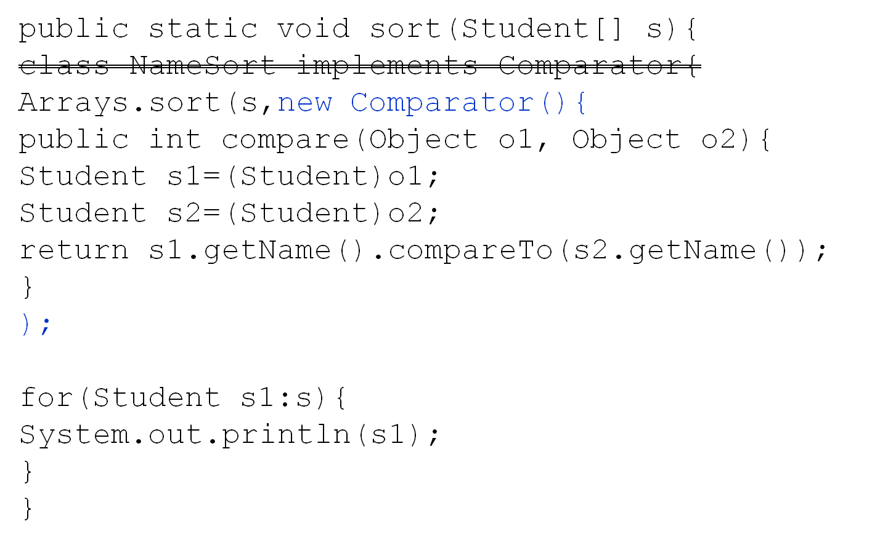

Slide 23
Test your understanding
class E {
E() {
System.out.print("E");}
static class Z {
Z(){
System.out.print("Z");}}
public static void main(String args[]){
new E.Z();}}
What is the result of attempting to compile and run the program?

Slide 24
class B {
private static String s1 = "s1";
final String s2 = "s2";
B () {new Z("s5","s6");}
static class Z {
final String s3 = "s3";
static String s4 = "s4";
Z (final String s5, String s6) {
System.out.print(???);
}}
public static void main(String args[]) {new B();}}
Which variable (in red) cannot be substituted for “???” without causing a compile-time error?

Slide 25
public class Base {
private static final int ID = 3 ;
private String name ;
public void methodA( final int nn ){
int serialN = 11 ;
class inner {
void showResult(){
System.out.println("Rslt= " + ??? );
}}
new inner().showResult();
}
}
Which variables would the statement in line 8 be able to use in place of “???” ?

Slide 26
class F {
public void m1() {Z.m1();}
private static class Y {
private static void m1() {
System.out.print("Y.m1 ");}
}
private static class Z {
private static void m1(){
System.out.print("Z.m1 ");
Y.m1();
}}
public static void main(String[] args) {
new F().m1();}}
What is the result of attempting to compile and run the program?

Slide 27
class Outer {
static class StaticNested {
static final int a = 25; // 1
static final int b; // 2
static int c; // 3
int d; // 4
static {b = 42;} // 5
}
class NonStaticInner {
static final int e = 25; // 6
static final int f; // 7
static int g; // 8
int h; // 9
static {f = 42;} // 10
}}
Compile-time errors are generated at which lines?

